Slide 1
איפיון מוצר
שם האפליקציה: vladiGram
חברי הצוות: Vladi Duynov

Slide 2
Main Pages

Slide 3
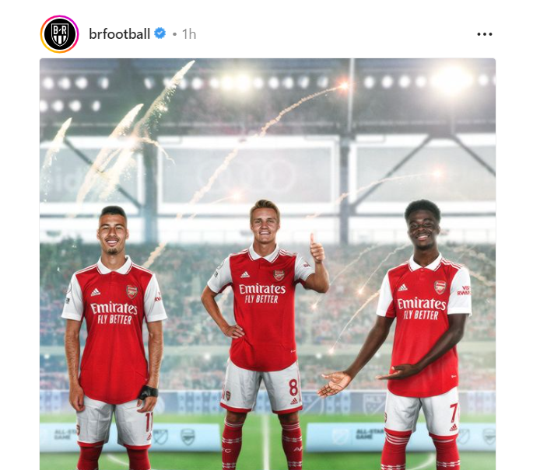
Home page
Header
Router view
Nav Footer

Slide 4
Main Flows

Slide 5
Flow
router View
Details
profile
Messenger

Slide 6
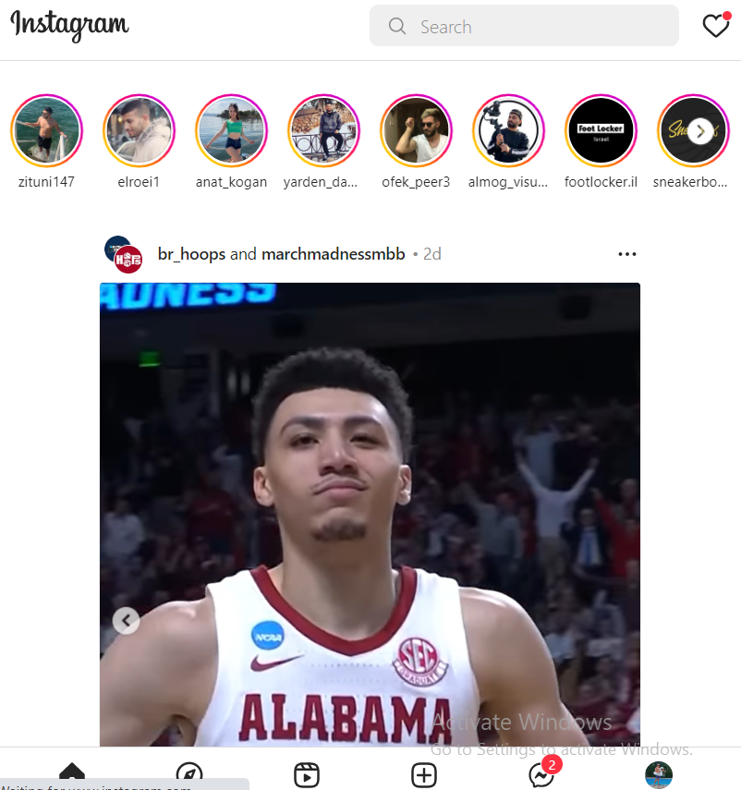
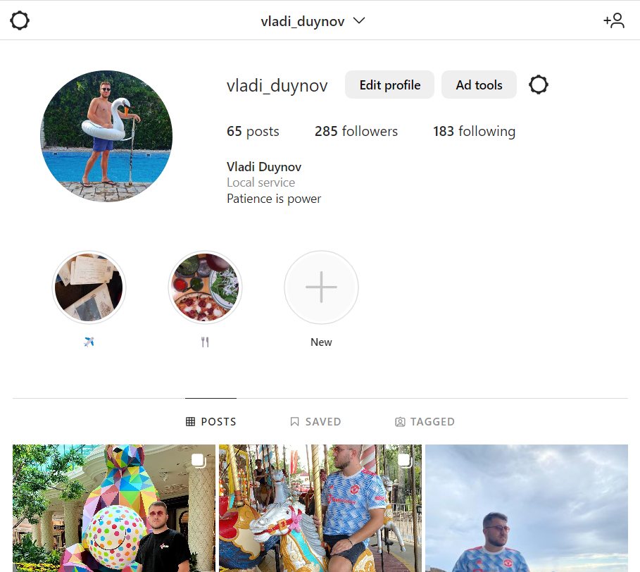
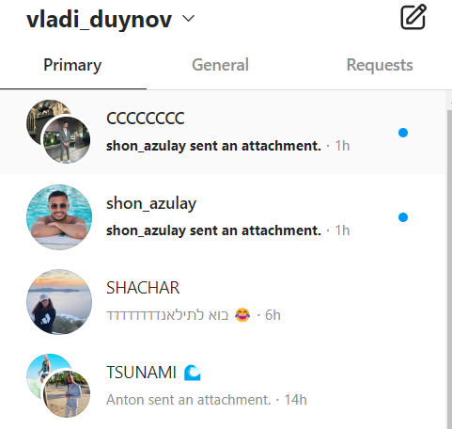
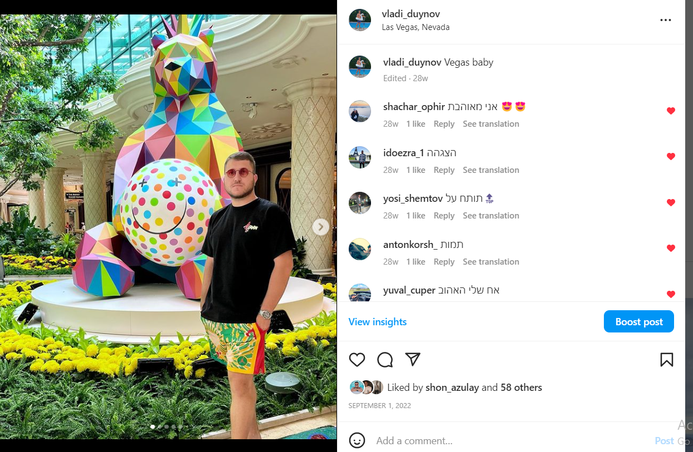
Router View (/) | Details (/profile/details) | Profile (/profile) | Messenger (/inbox)
Shows main information displayed by list of posts that it gets from db | After getting into the user profile and clicking on one of the posts, the detail section will appear with the info with number of like and comments will be shown | By clicking on the user photo gets into the profile. In the profile there will be shown the number of the posts and the post themselves | By clicking on the messenger icon, it will get to the messages and interactions with other users.

